Slide 1



Predicting Severe Asthma Exacerbations
A Genome-Wide Association Study using Random Forests Classifiers
Mousheng Xu, PhD
Dec 2025 | GTIIT’s 3rd International Symposium Presentation
Notes:
Good morning/afternoon, everyone. I’m Mousheng Xu.
First, I would like to thank Dr. Dganit to invite me to the symposium and give me the chance to speak.
Today, I’ll be presenting our work on predicting severe asthma attacks using Random Forest classifiers—a study that sits at the intersection of genetics and machine learning. This research addresses a critical need in personalized medicine: identifying high-risk patients before an event occurs.

Slide 2
Self Introduction
Mousheng Xu, PhD
Head of Biosciences, A Private Company In Singapore
•
20+ Years Experience: Bridging computational biology, statistical genetics, and machine learning.
•
Academic Foundation:
B.S. in Genetics (Wuhan University)
M.S. in Biochemistry & Molecular Biology, M.S. in Computer Science (University of Kansas)
PhD in Bioinformatics (Boston University; Harvard Medical School)
Postdoc in Cancer Genetic Epidemiology (Harvard T.H. Chan School of Public Health).
Key Achievements:
•
○
Led large-scale GWAS & NGS pipelines.
○
Founded Hubei Vidagen (Genetic Testing).
○
Scientific Breakthrough Award (ATS 2009).
Notes:
My 20+ year career has been defined by bridging computational biology, statistical genetics, and machine learning.
I have a strong academic foundation from Harvard and Boston University, but my career has focused on application. Whether leading large-scale GWAS pipelines at Harvard or founding a genetic testing company, my goal has always been to translate complex "Big Data" into actionable clinical and commercial insights.

Slide 3


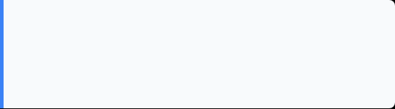
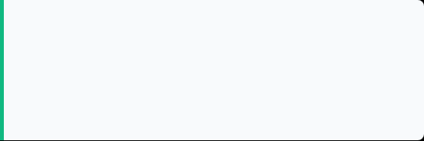
The Clinical Challenge：Severe Asthma Exacerbations
Definition
Severe Asthma Exacerbations: emergency room visit or a hospitalization for asthma symptoms.
Prognostic Significance
The ability to predict severe asthma exacerbations would therefore have direct prognostic significance and might form the basis for the development of earlier therapeutic interventions.
Notes:
The core clinical problem we addressed is prediction.
Severe asthma exacerbations—defined as events requiring emergency room visits or hospitalization—are dangerous, costly, and difficult to foresee. The ability to predict this risk early using genetic markers would have direct prognostic significance, forming the basis for earlier and more effective therapeutic interventions.

Slide 4






The "Small N, Large P" Problem
Sample Size (N)
Standard Method
Predictors (P)
127 cases
290 controls
417 total
Logistic Regression
> 550,000
Struggles when predictors (P) vastly outnumber samples (N). Cannot easily model complex interactions.
Single Nucleotide Polymorphisms (SNPs) + Clinical Traits
Notes:
Our analysis faced a classic but severe statistical hurdle: "Small N, Large P."
We had a high-quality dataset of 417 subjects (Small N), but we had to screen over 550,000 genetic and clinical predictors (Large P).
Standard methods like Logistic Regression fail in this scenario because they cannot handle such high dimensionality without overfitting. We needed a machine learning tool specifically designed for this scale.

Slide 5

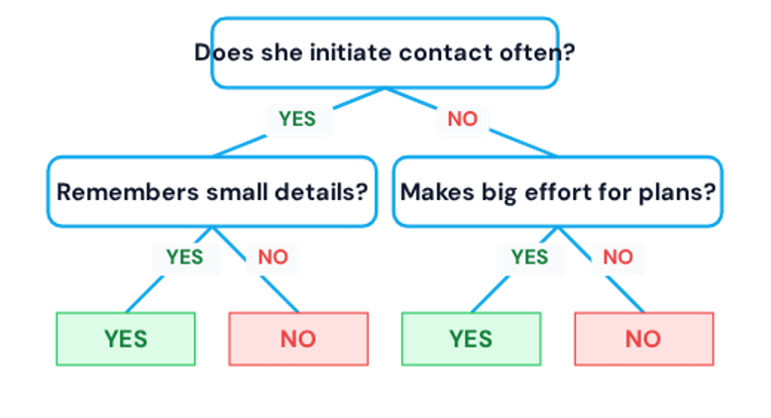


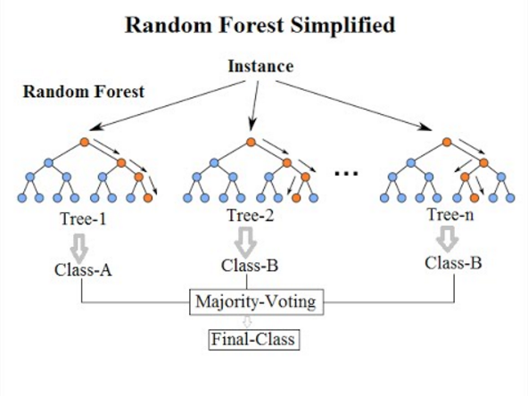
Machine Learning With Random Forests
Leveraging ensemble power for robust predictive modeling.
Key Concepts of Random Forests
A decision tree predicts outcomes by splitting data based on feature values.
An ensemble of many decision trees forms a "forest".
Each tree uses random samples of the data and considers only random features at each split, enhancing diversity.
Voting Mechanism: The model aggregates predictions by taking the votes from each decision tree to determine the final outcome.
Handles nonlinear, high-dimensional data effectively, crucial for complex datasets.
Provides valuable feature importance scores, indicating which variables are most predictive.
Notes:
Our solution was the Random Forest classifier.
As the diagram on the left shows, a single Decision Tree can be unstable. However, the Random Forest (on the right) uses an ensemble of hundreds of trees.
Each tree is trained on a random subset of data and votes on the outcome. We then use a "Majority Vote" mechanism to determine the final prediction. This "wisdom of the crowds" approach drastically increases stability and accuracy compared to any single model.

Slide 6



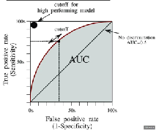

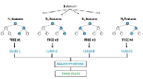
Key Terminology
SNP
Importance Score
AUC
Single Nucleotide Polymorphism
A one-letter difference (A/C/G/T) on DNA
May influence traits or disease risks
A DNA “mutation” (inappropriate but close)
Random Forest predictive power: contribution to the predictive accuracy
The higher, the more contribution
Area Under the Curve
A performance metric ranging from 0 to 1.
Measures the ability to distinguish between classes.
0.5 is random guessing
1.0 is perfect prediction.
Notes:
Briefly, here are the key terms for this analysis:
SNP (Single Nucleotide Polymorphism): The single-letter genetic variations we used as predictors.
Importance Score: The metric Random Forest uses to rank predictors by their predictive power.
AUC (Area Under the Curve): Our measure of success. 0.5 is a random guess; 1.0 is perfect prediction. We aim to maximize this.

Slide 7
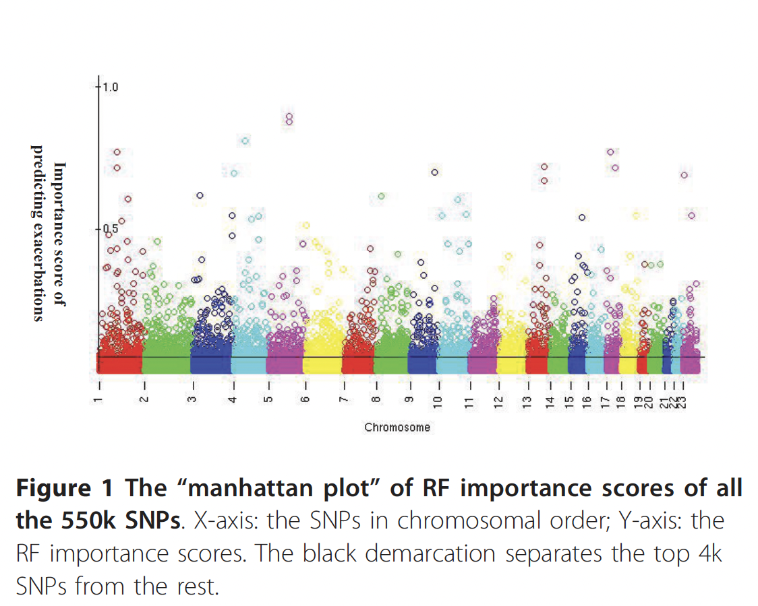
Methodology: Feature (SNP) Selection
Step 1: Initial Screen
Step 2: Ranking
Step 3: Prediction
RF
RF
RF
4k SNPs
4k SNPs
…
4k SNPs
Top 4k SNPs Importance
Score
Reranked 4k SNPs Importance
Score
RF
RF
Build final models using Top N SNPs (10, 40, 160, 320) + 4 Clinical Traits.
Notes:
We developed a three-step filtering pipeline to find the true genetic signal among the noise:
Initial Screen: We scored all 550,000 SNPs using the Random Forest Importance metric.
Ranking: We isolated the top 4,000 signals and re-ran the model to stabilize the rankings.
Prediction: Finally, we built models using increasing subsets of these top SNPs (Top 10, 40, 160, etc.) combined with clinical traits to find the peak performance.

Slide 8
Visualizing the Signal
The RF Importance Landscape
Unlike a traditional GWAS Manhattan plot which shows -log(p-values), this plot visualizes Random Forest Importance Scores across the genome.
The "peaks" represent SNPs that contribute most significantly to classifying a patient as an "Exacerbator" vs. "Non-Exacerbator".
We identified a clear signal distinguishing the top predictive SNPs from the genomic background noise.
Notes:
This is the result of that initial screening.
This plot visualizes the Random Forest Importance Score across the entire genome. Unlike traditional p-value plots, the distinct "peaks" you see here represent the specific genetic locations that the algorithm identified as most critical for classifying a patient as an "Exacerbator."
We successfully identified a clear signal distinguishing predictive markers from the genomic background noise.

Slide 9
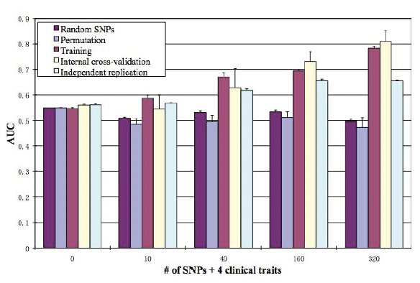
4 months after publication, Editor:
Genetics Improves Prediction
Area Under the Curve (AUC) in Independent Replication Cohort
Key Finding: Adding genetic markers significantly improved prediction over clinical history alone. The model plateaued at 160 SNPs, suggesting a robust genetic signature for exacerbation risk.
Notes:
Here is the key result.
The gray bar shows the model using only clinical traits—it achieved an AUC of 0.54, which is barely better than random.
However, as we added the top genetic markers (the blue and green bars), the accuracy climbed significantly. We reached a peak AUC of 0.66 using the Top 160 SNPs. This proves that the genetic signature provides predictive value that clinical history alone cannot capture.

Slide 10
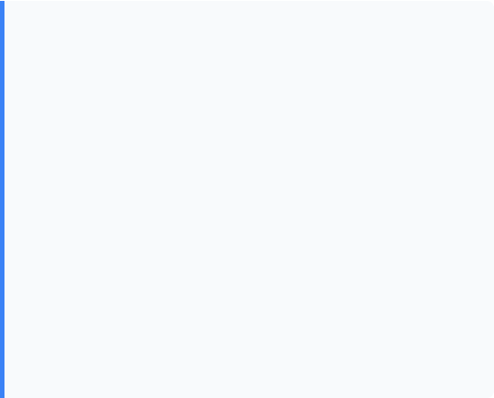
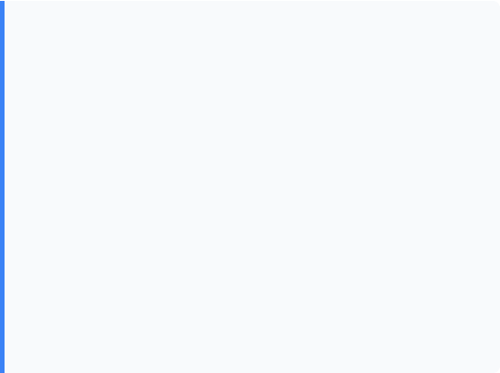


Validation & Impact
Recognition
Rigorous Validation
This work was highlighted for its innovative approach:
We did not just test on the training data.
•
Permutation Testing: Confirmed results were not due to chance.
ATS 2009: Featured at the "Scientific Breakthroughs of the Year" symposium.
•
•
Independent Replication: The model was tested on a separate cohort of 164 subjects, maintaining an AUC of 0.66.
Impact: Categorized as "Highly Accessed" (1,120 accesses 4 months after publication) by BMC Medical Genetics, influencing future ML-GWAS integration studies.
•
Notes:
In machine learning, validation is everything. We ensured our results were robust through:
Permutation Testing: Proving our results were not due to chance.
Independent Replication: Most importantly, we tested the model on a completely separate cohort of 164 subjects, and the AUC held steady at 0.66.
This rigorous validation is why the work was recognized as a "Scientific Breakthrough of the Year" by the American Thoracic Society (ATS).

Slide 11

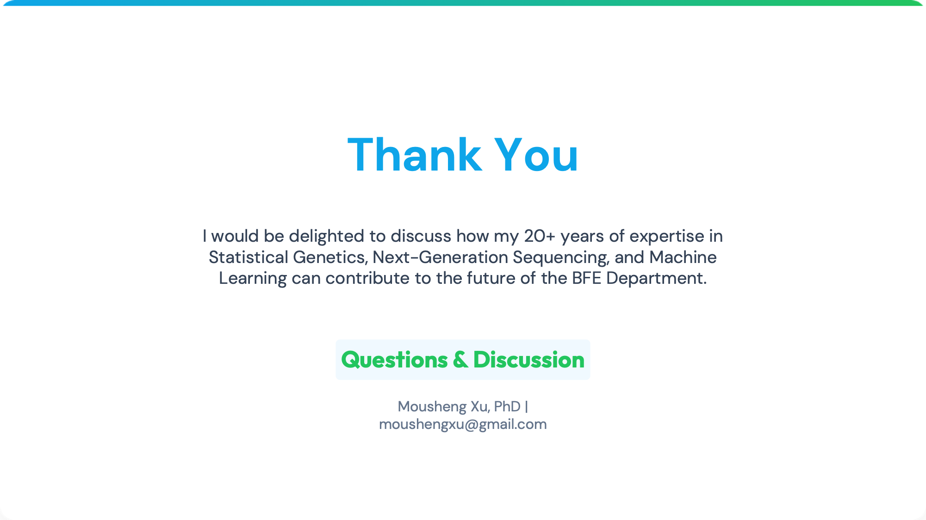
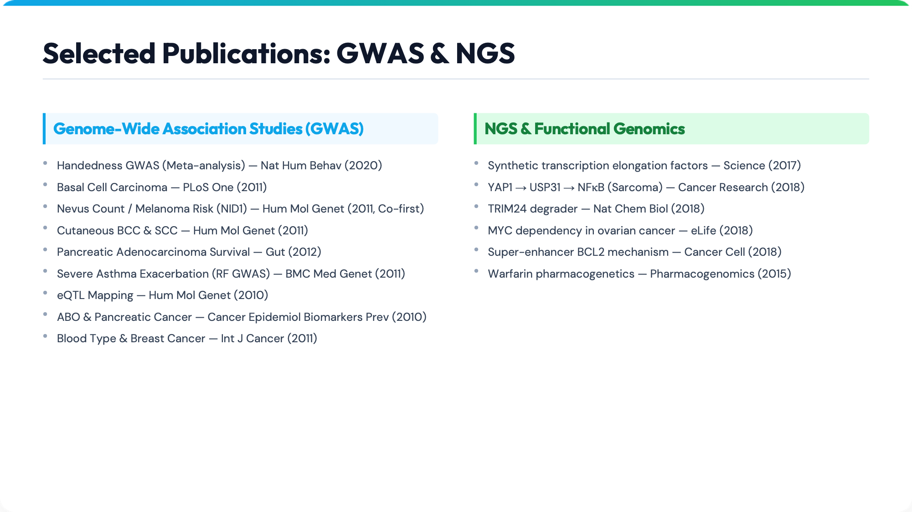
Thank You
Questions & Discussion
Mousheng Xu, PhD
moushengxu@gmail.com
Notes:
My research impact extends well beyond this study.
I have published extensively in both Genome-Wide Association Studies (GWAS) and Next-Generation Sequencing (NGS). My work includes high-impact papers in journals like Science and Nature Cell Biology, covering topics ranging from Melanoma risk and Pancreatic cancer survival to the fundamental mechanisms of transcription.

Slide 12
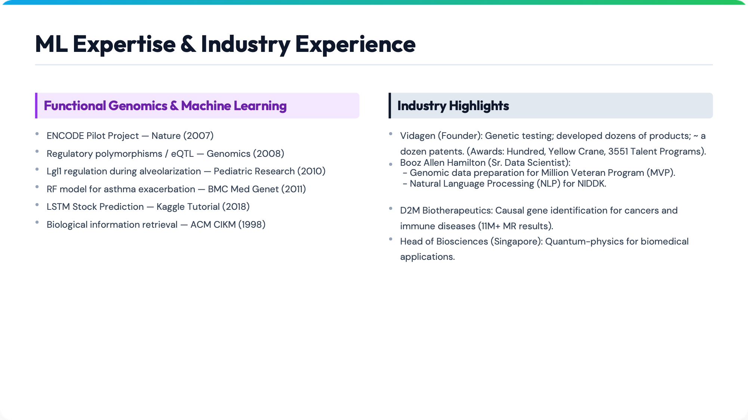
Thank You
Questions & Discussion
Mousheng Xu, PhD
moushengxu@gmail.com
Notes:
I also bring strong industry and technical depth.
Beyond Random Forests, I have deployed Natural Language Processing (NLP) models for NIH datasets and LSTM deep learning models for time-series prediction.
As a founder of Vidagen and a lead at D2M and Booz Allen, I have a proven track record of translating these theoretical models into functional, large-scale genomic pipelines in the private sector.

Slide 13
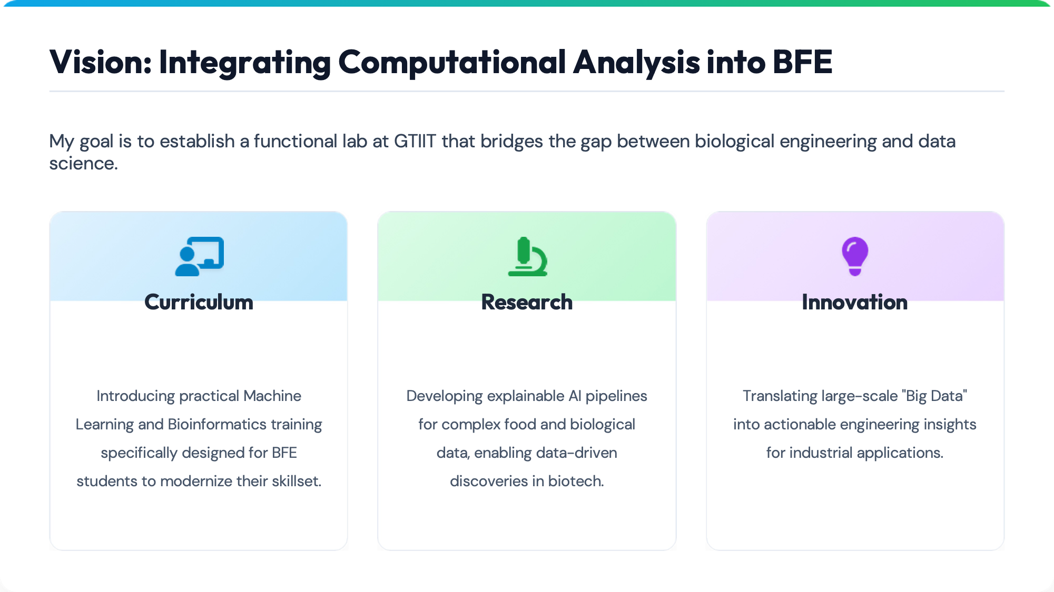
Mousheng Xu, PhD
moushengxu@gmail.com
Notes:
Moving forward, my vision for the BFE department is to establish a lab that bridges biology and data science.
Curriculum: I will fill the skills gap by teaching practical Machine Learning and Bioinformatics to students.
Research: We will apply explainable AI to complex food and biological data.
Innovation: We will translate large-scale omics data into actionable engineering insights for industrial applications.

Slide 14

Thank You
Questions & Discussion
Mousheng Xu, PhD
moushengxu@gmail.com
Notes:
Thank you very much for your time.
I would be delighted to discuss how my expertise can contribute to the future of the BFE Department. I welcome your questions.

